Slide 1
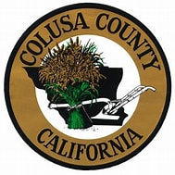
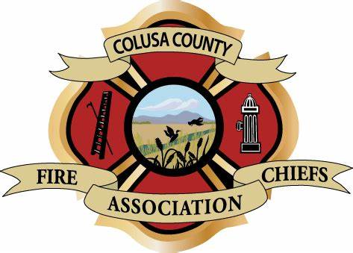

Colusa County Fire Mitigation Coordinator Grant- Community Meeting

Slide 2

Tonight’s Agenda
OBJECTIVE:
1. Introduce to you the planning project and partners involved in wildfire mitigation.
2. Assess your wildfire risk and identify areas that need wildfire mitigation.
  Where is there wildfire risk in Colusa County?
3. Identify mitigation practices for the at-risk area.
  Your Feedback is important to us! Worksheet/Survey

Slide 4

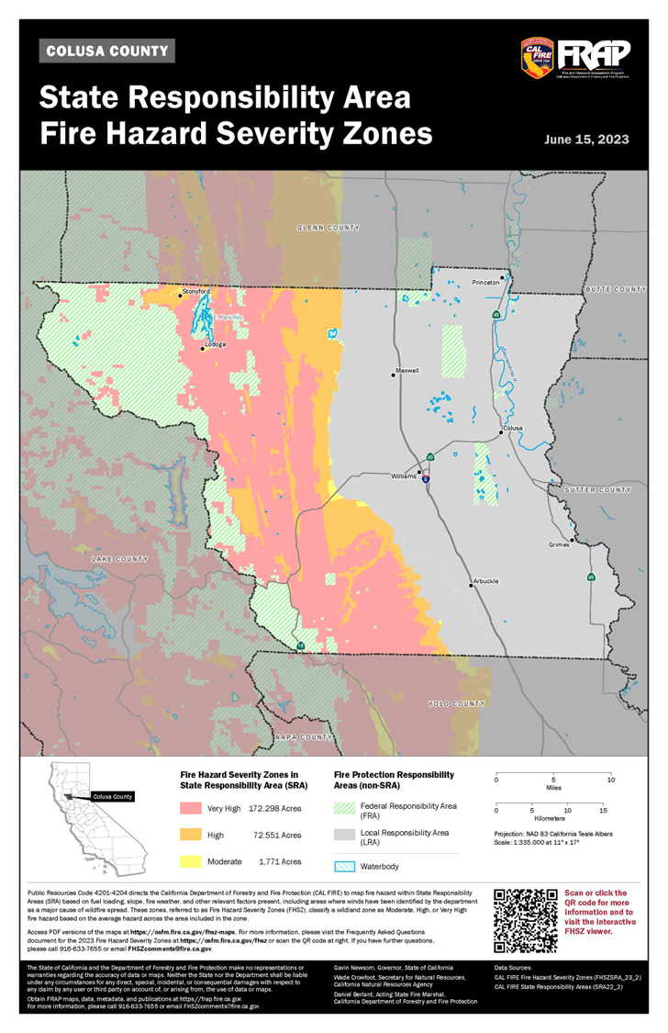

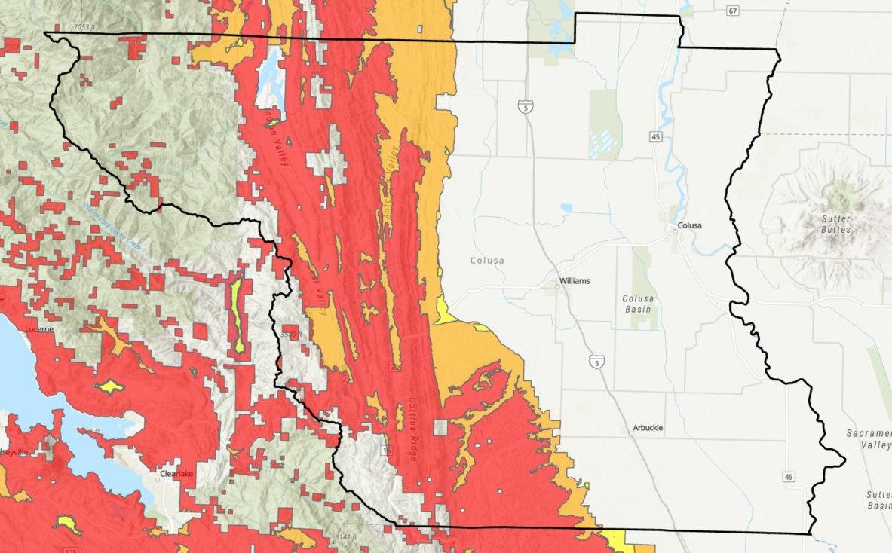
CalFire- FHSZ
How CalFire classifies the severity of fire hazard across the state.
https://osfm.fire.ca.gov/what-we-do/community-wildfire-preparedness-and-mitigation/fire-hazard-severity-zones

Slide 5
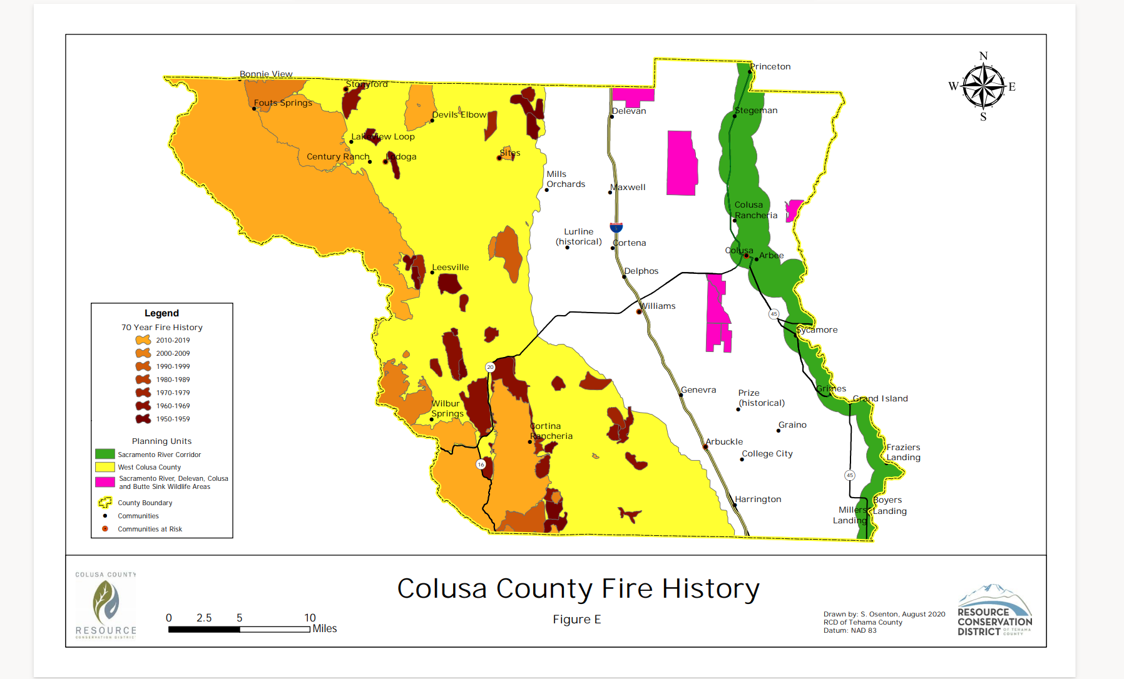

Slide 6
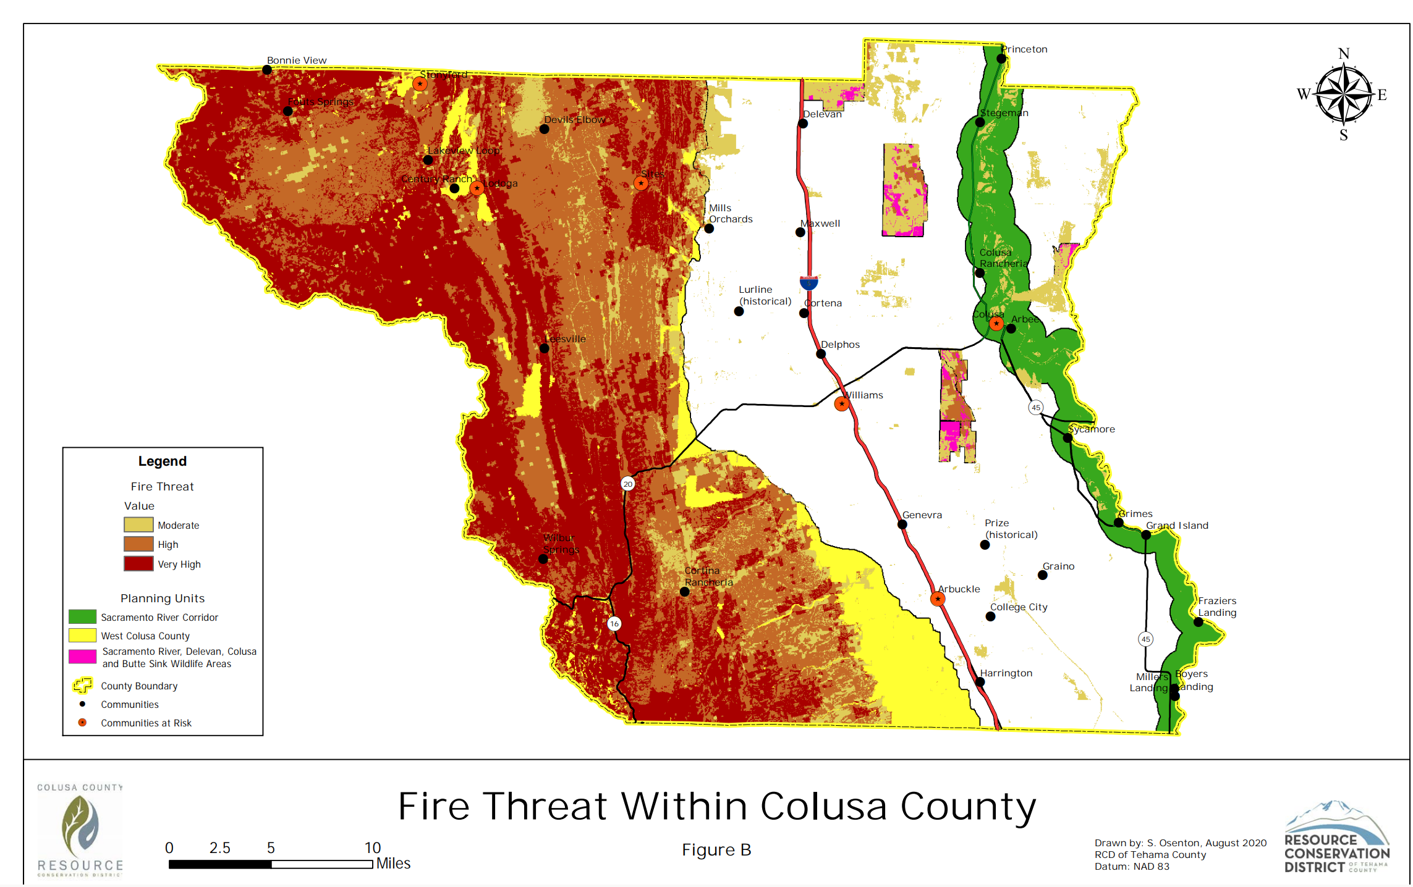

Slide 7
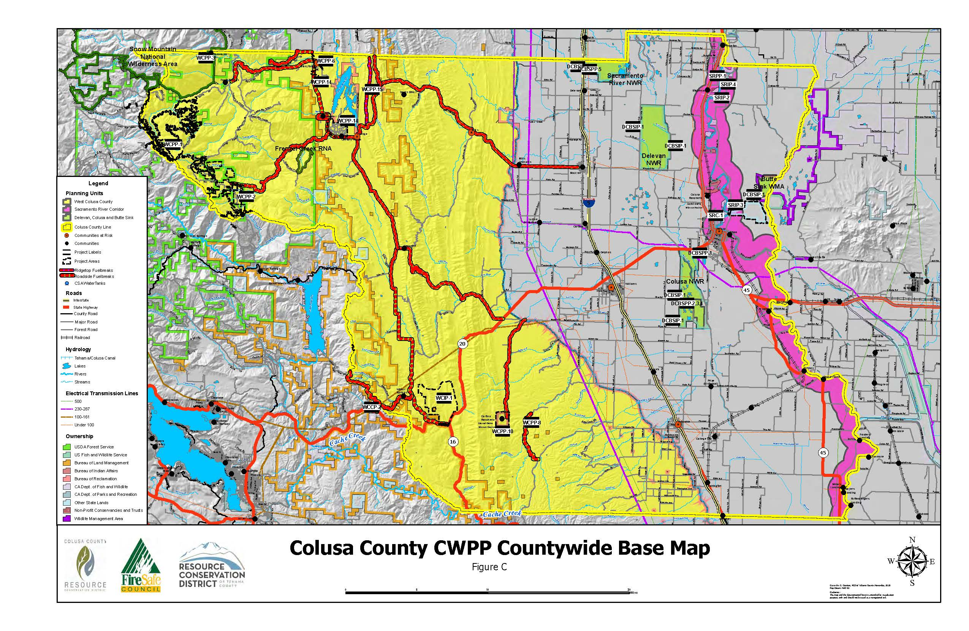

Slide 8
Wildfire Mitigation Practices/Programs
1. Fuel Management and Fuel Reduction
2. Organizational/Programmatic
3. Outreach and Education
4. Infrastructure

Slide 9
Fuel Reduction/Management
  Upper Watershed Vegetation/Fuels Management Actions That Protect the Watersheds and Water Quality of Those Streams Within the Mendocino National Forest
  Fuels Reduction on Private Lands Adjacent to Public Wildlands
  Creating and Maintaining Multi-Parcel Fuel Breaks Surrounding Communities
  Upper Stony Creek Project*
  M5 Roadside Hazard Project*

Slide 10
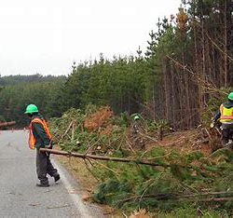
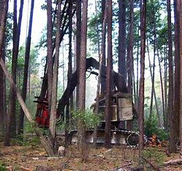
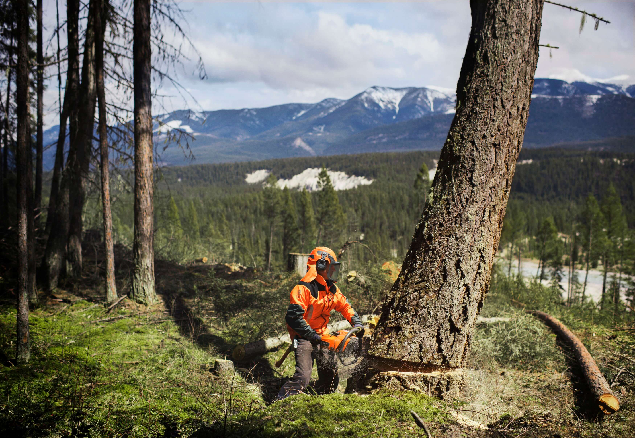
Fuel Management Practices
  Thinning

Slide 11
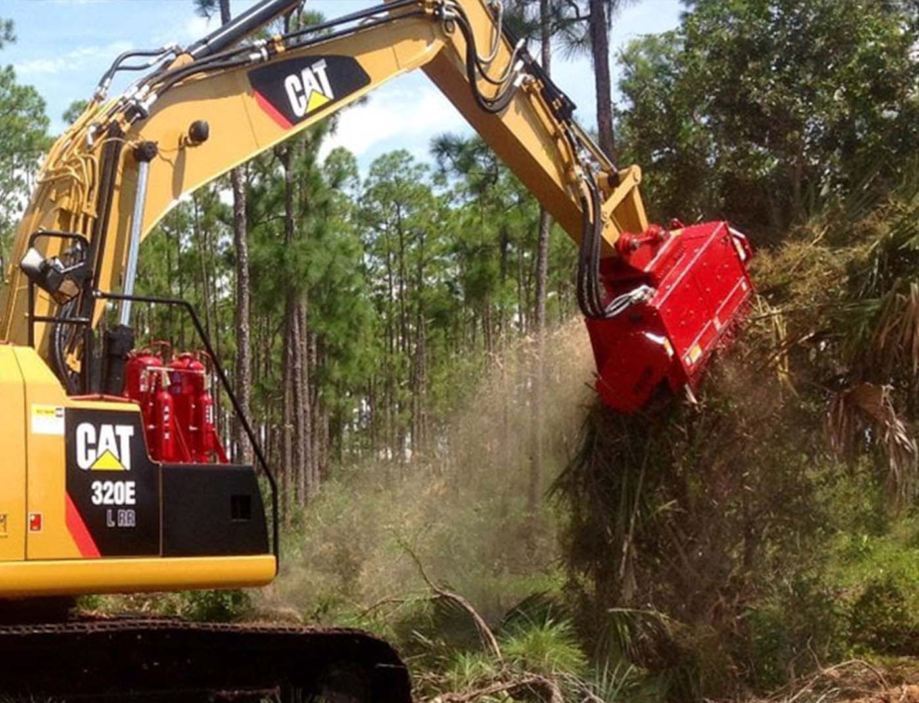
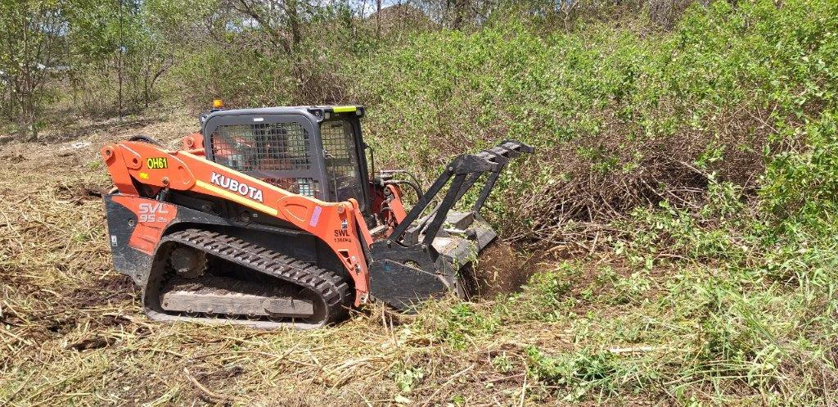
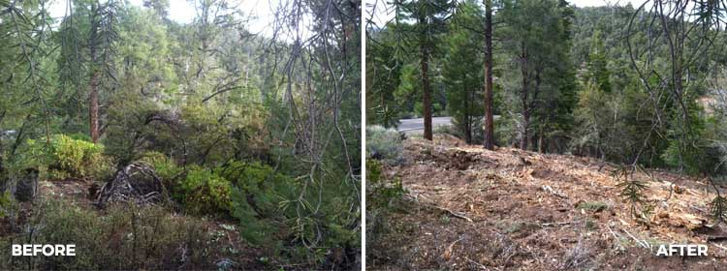
Mastication
z

Slide 12
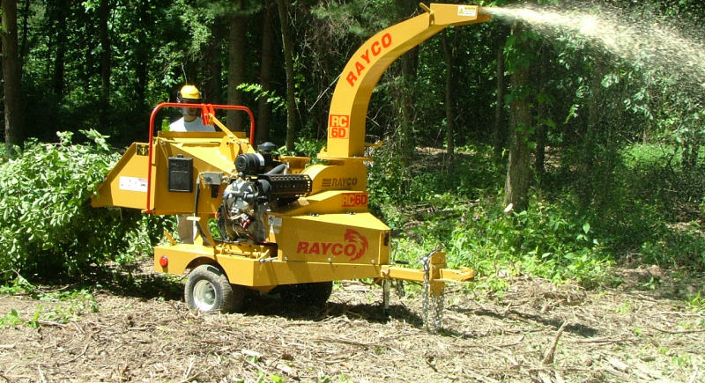
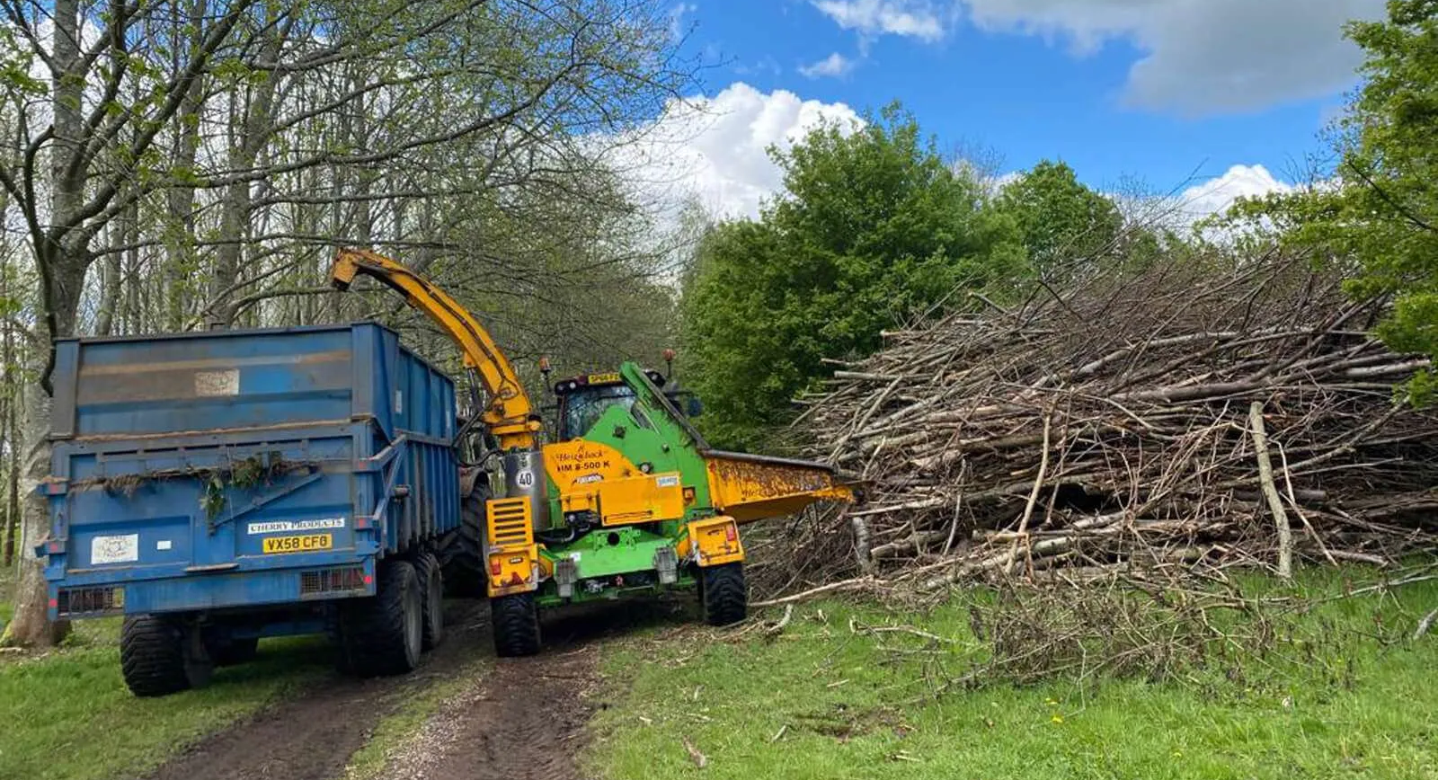
Chipping
z

Slide 13
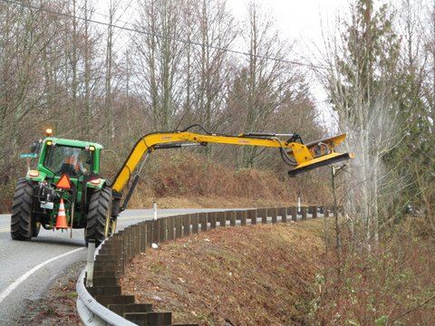
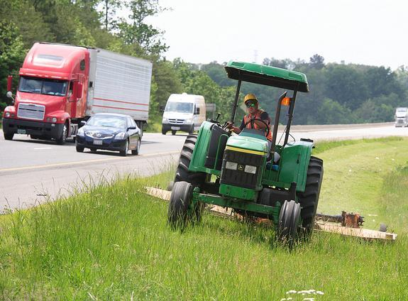
Mowing
z

Slide 14
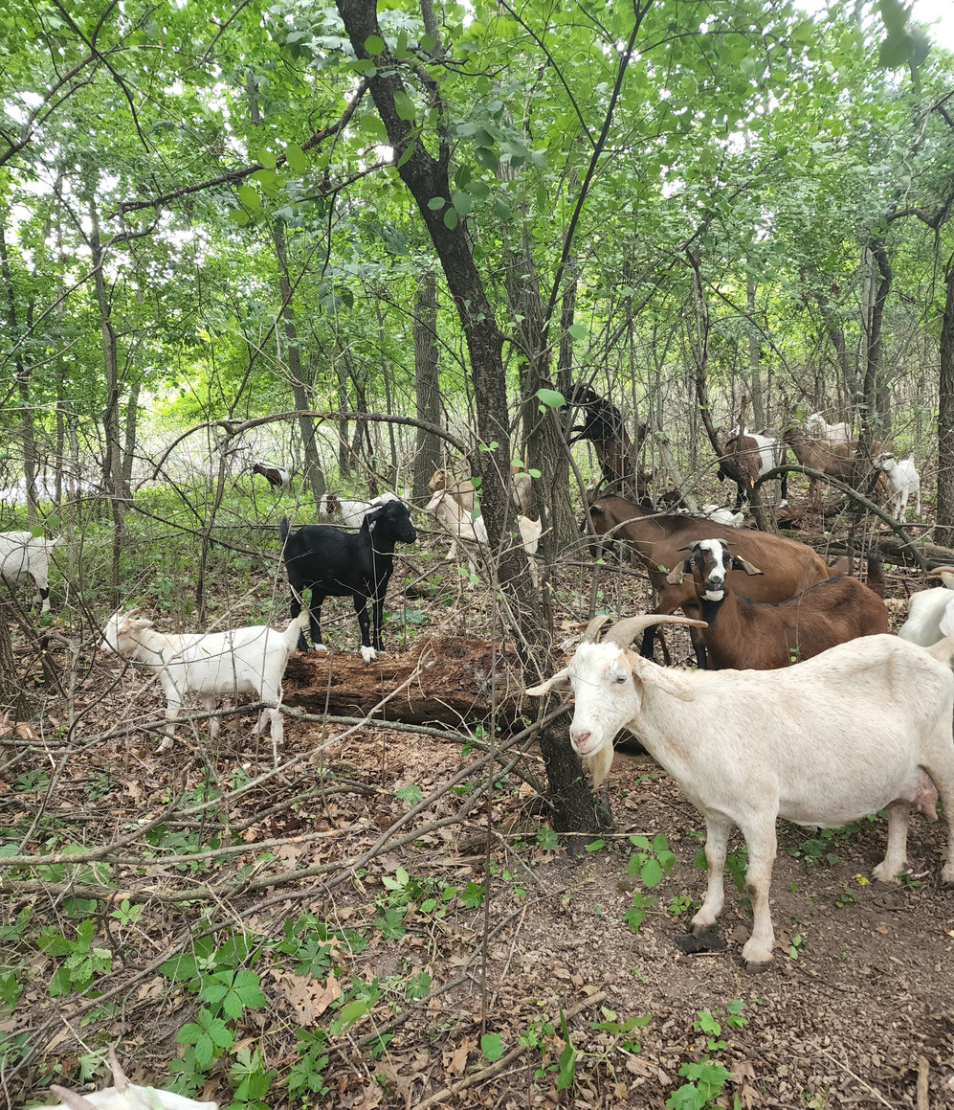
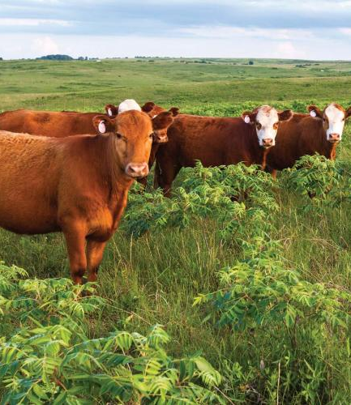
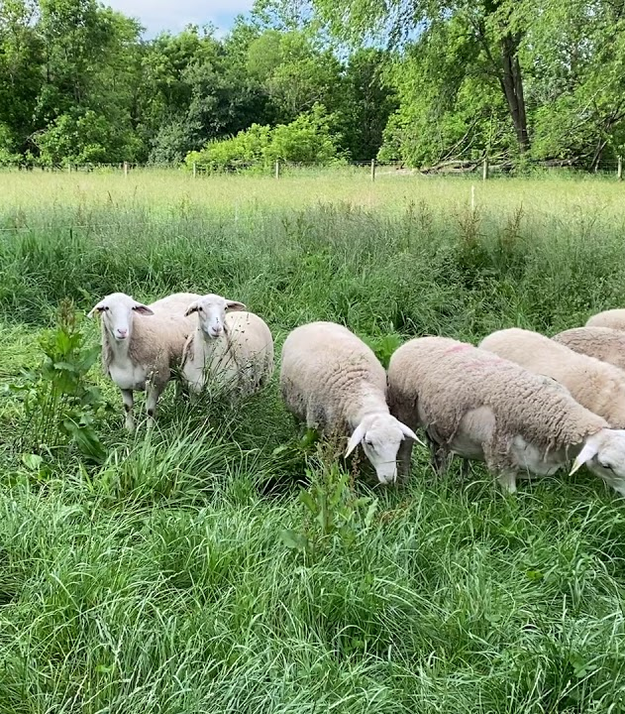
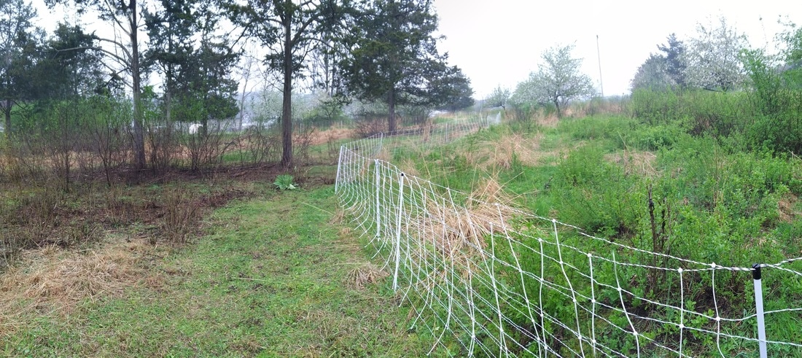
Prescribed Grazing

Slide 15
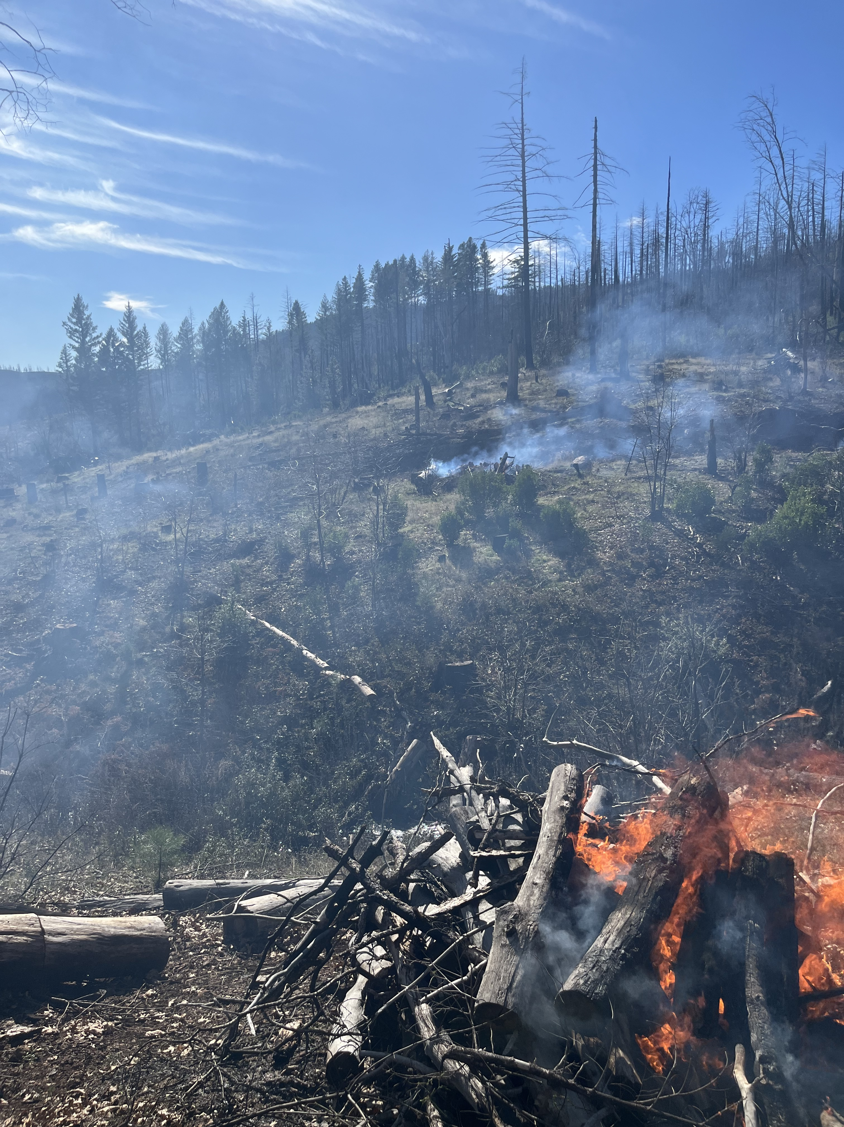
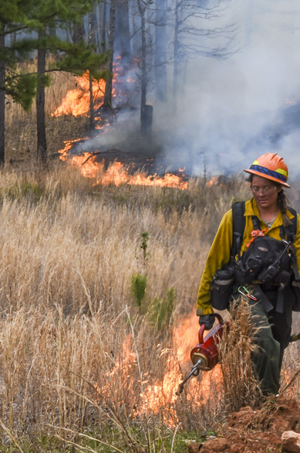
Prescribed Fire
z

Slide 16
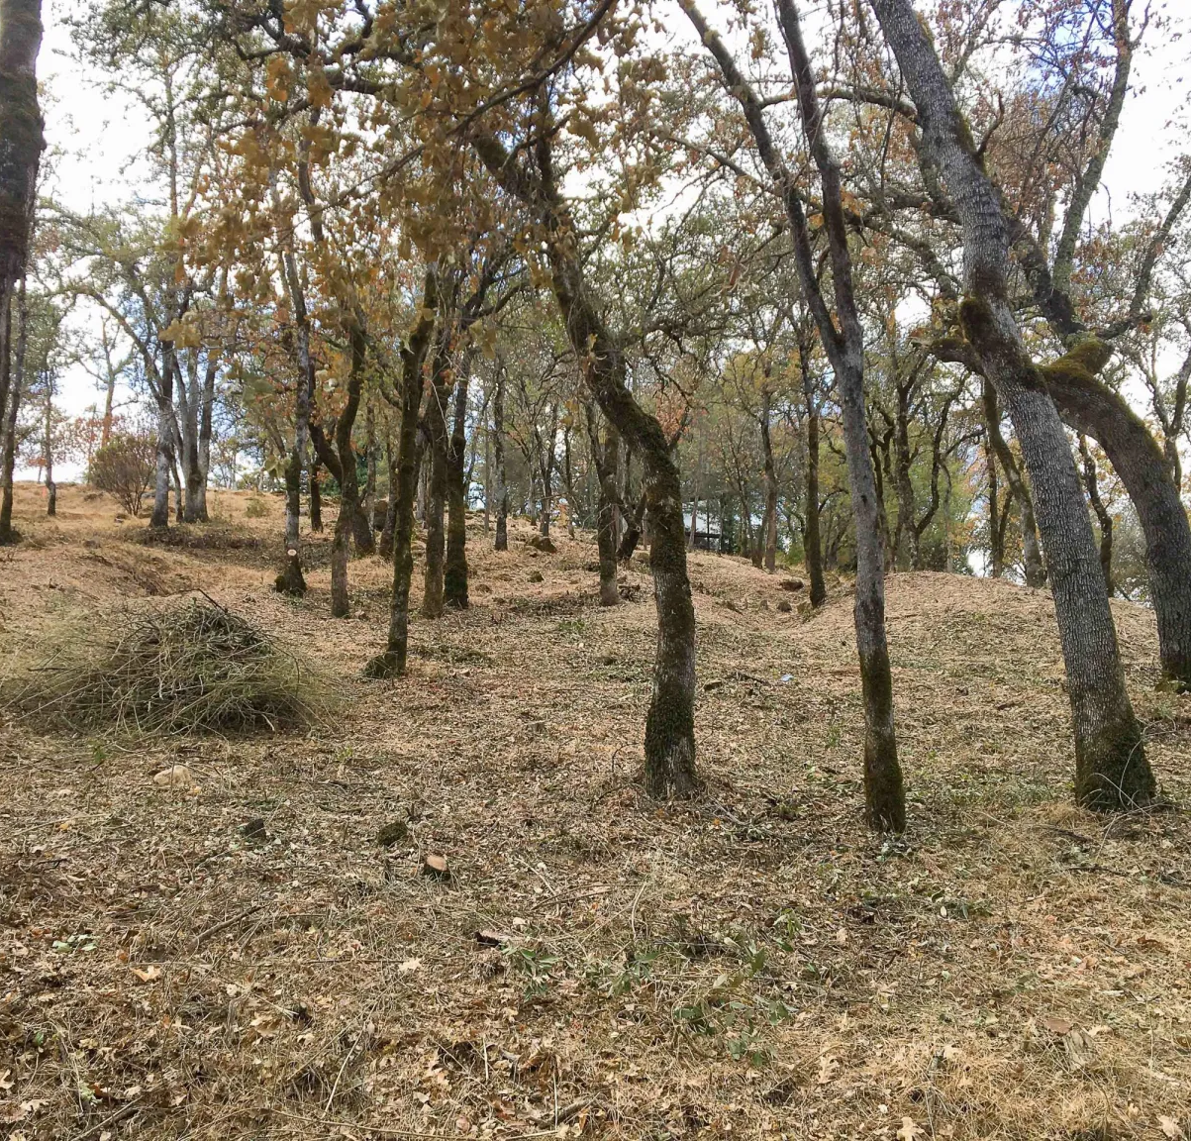
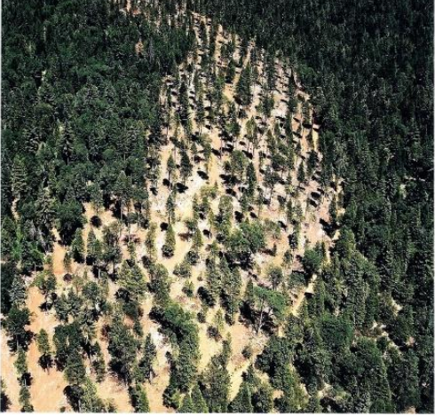
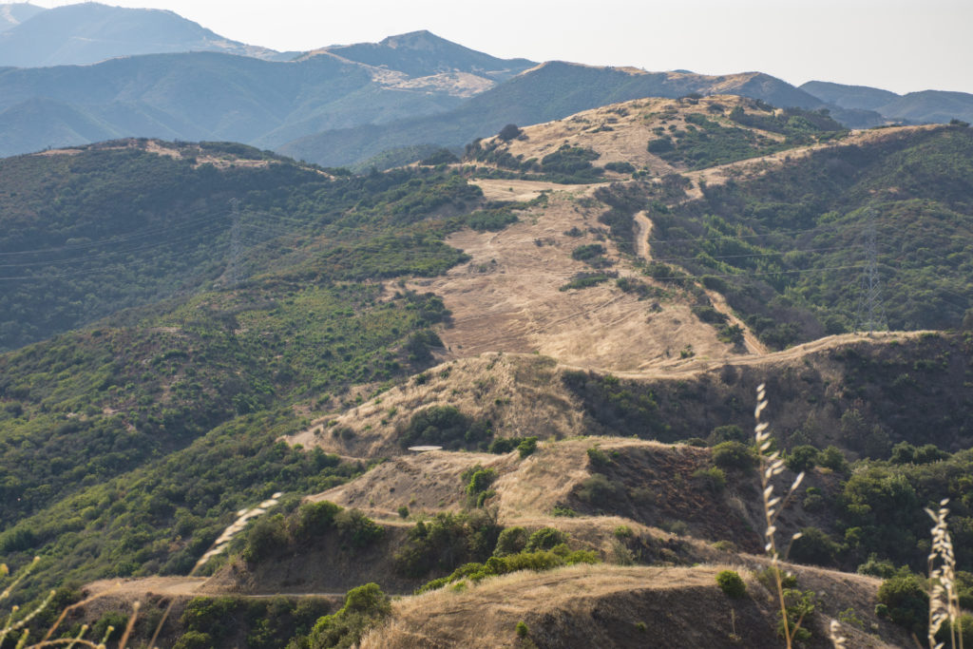
Fuel Breaks
Shaded Fuel Breaks
Strategic/Ridgetop Fuel Breaks

Slide 17
Fuel Breaks Continued
Development and/or Improvement of Roadside Fuel Breaks
  Maxwell-Sites Road, Sites-Lodoga Road
  Stonyford-Lodoga Road East Park Reservoir Rd
  Indian Springs Road (County Road M-18)
  Fouts Springs Rd (County Road M-10)
  Lake View Loop (entire road loop)
  Goat Mountain Road (County Road M-42)
  Rail Canyon Road (County Road M-401)
  Bear Valley Road, Wilbur Springs Road
  Walker Ridge Road
  Leesville Road
  Spring Valley Road/Manzanita Road

Slide 18
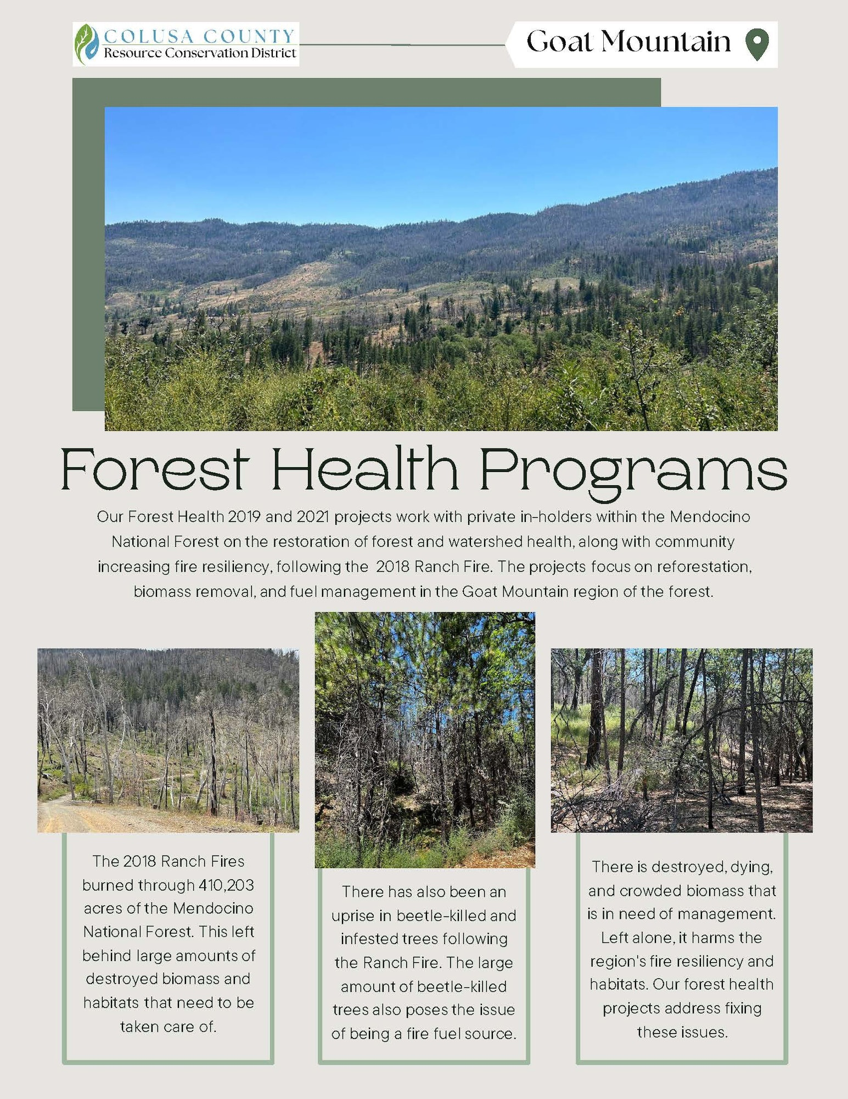
RCD Wildfire Resiliency Projects
Post Fire Recovery and Reforestation
Roadside Shaded Fuel Breaks and Pest Management

Slide 19
Organizational Projects
Importance of CWPP
Establishment of Colusa County Fire Safe Council
Establishment of Colusa County Prescribe Burn Association
Development of a Countywide Outreach and Education Program

Slide 20
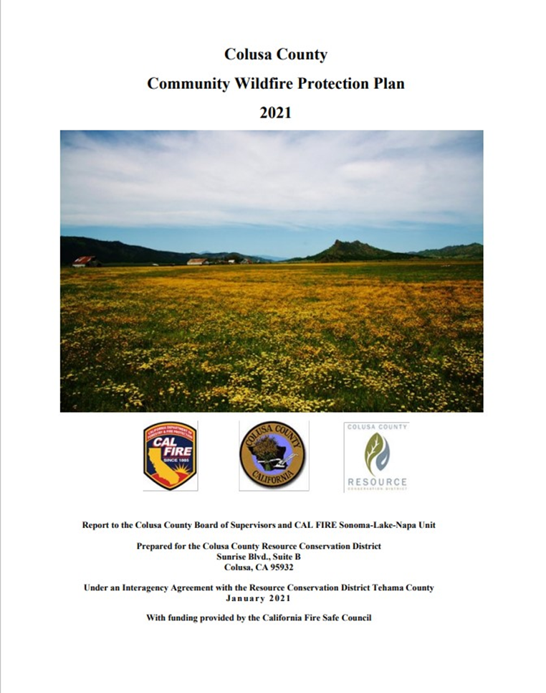
CWPP
Framework for County-Wide Wildfire Mitigation Efforts

Slide 21
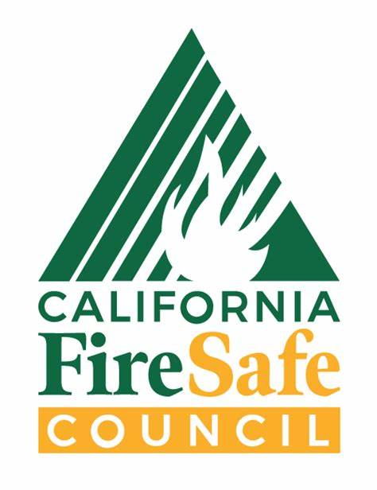
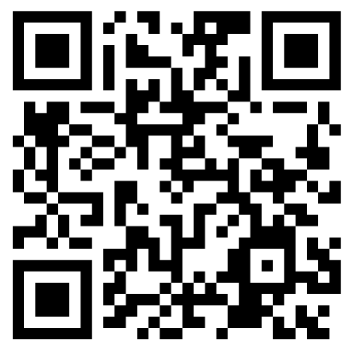
Fire Safe Councils
Fire Safe Councils are grassroots, community-led organizations that mobilize residents to protect their homes, communities, and environments from catastrophic wildfire.
Helps minimize wildfire risks to properties/homes and increases insurability
Creates strong partnerships with first responders.
Concrete and well-established ability to obtain funding for wildfire mitigation efforts!
Will pave the way for continuing this grant’s efforts and any projects identified and created!
Yolo FSC

Slide 22
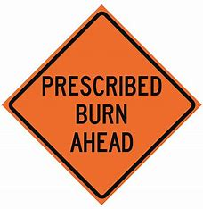
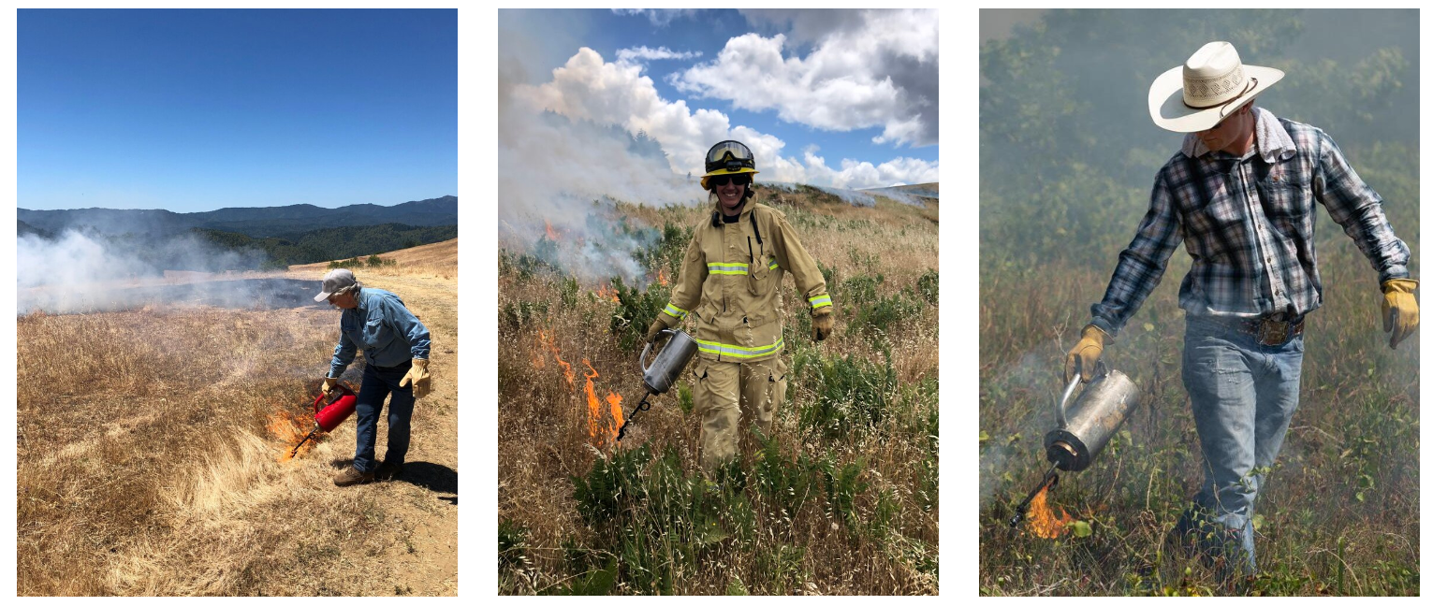
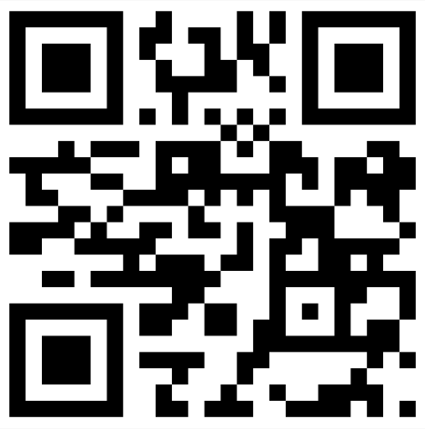
Prescribed Burn Associations
Community based mutual aid networks that help private landowners put good fire back on the land.

Slide 23
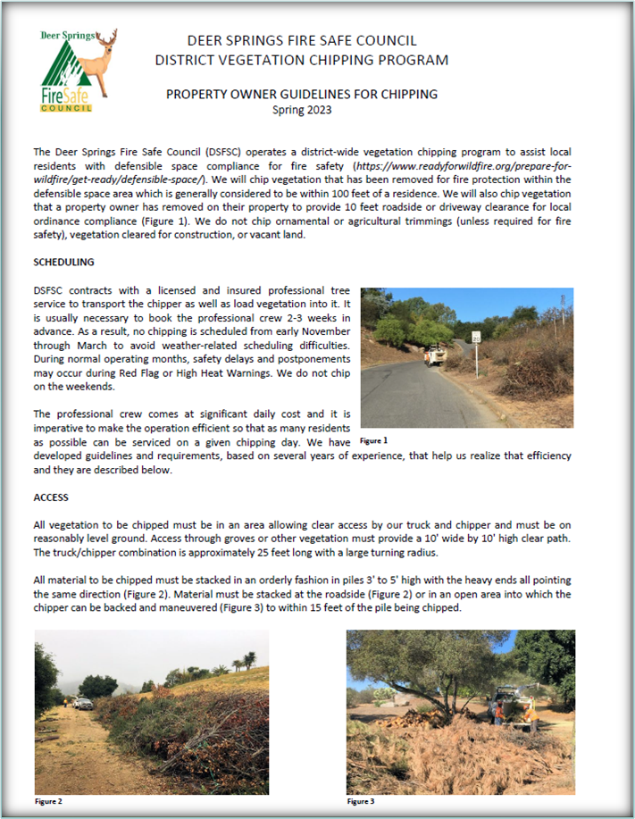
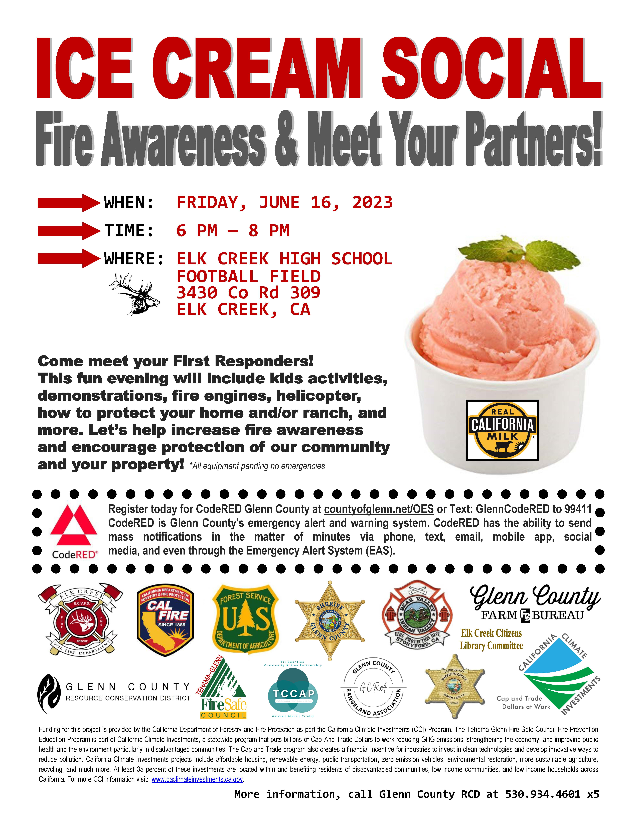
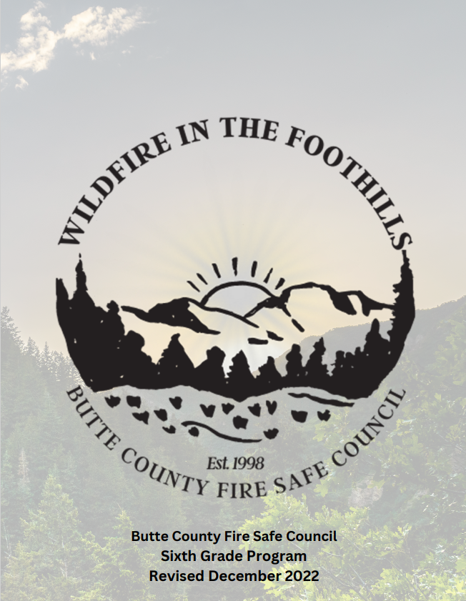
Community Programs, Outreach, and Education
Community Chipping – Deer Springs FSC
Community Outreach – Glenn RCD
Youth Education – Butte FSC

Slide 24
Infrastructure Projects
Improved Support of State Defensible Space Requirements
Development Firewise Communities
Development of Formal Evacuation Routes/Safety Zones and Related Maps
Investment by Local Water Provider to Install Improved Fire Water Delivery Systems throughout the county
Watershed Assessments
Development of Mendocino National Forest Type Conversion Data Layers into Publicly Available Maps

Slide 25
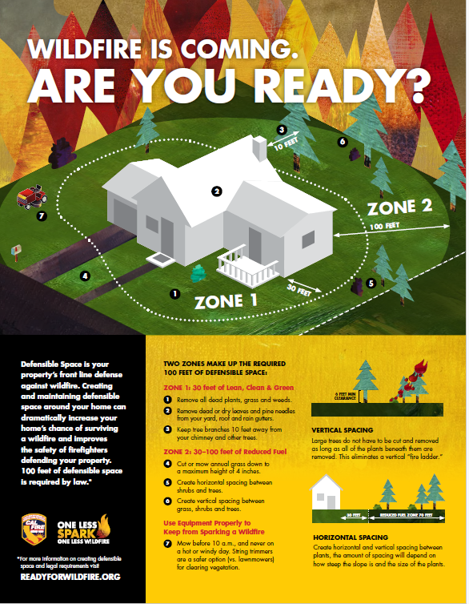
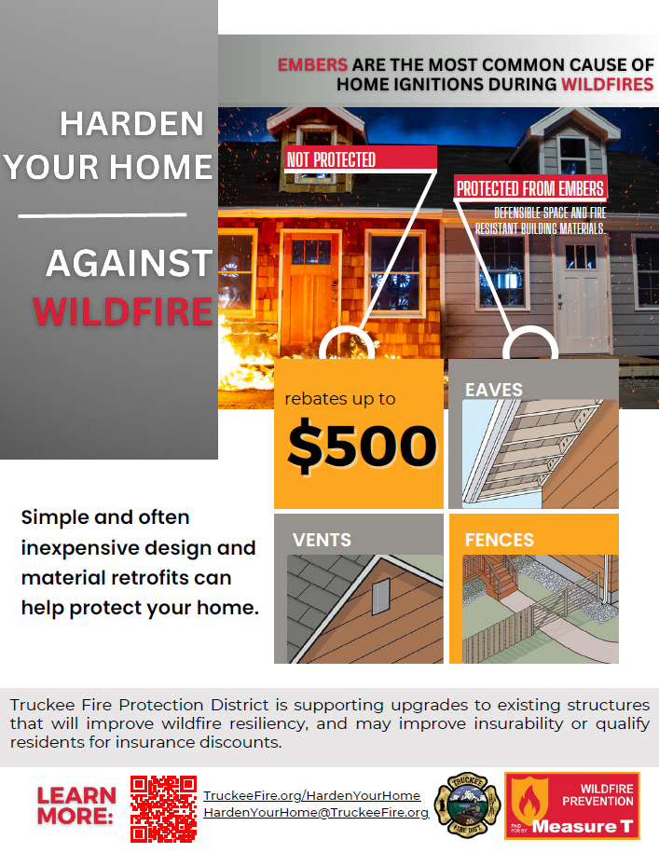
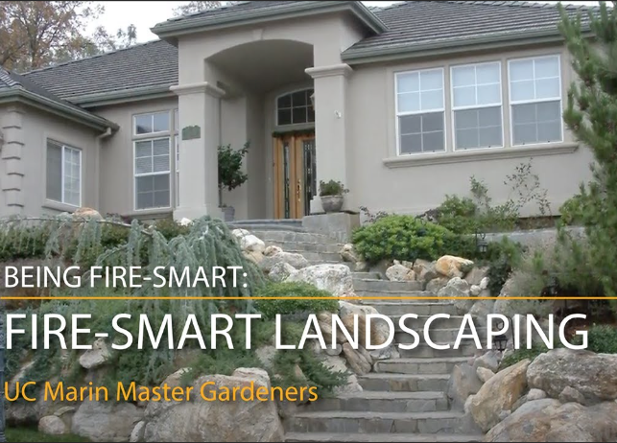
Defensible Space
Home Hardening
Fire Smart Landscaping
Notes:
Deer Springs Fire Safe Council- great example
Truckee Fire Protection District- great examples

Slide 26
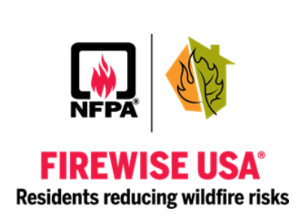
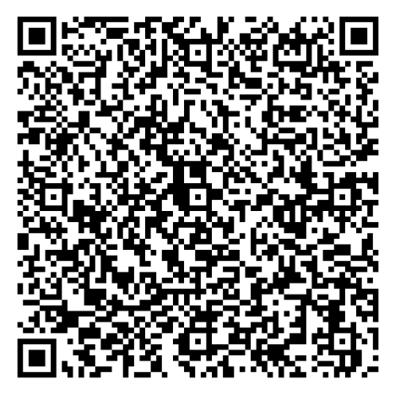
Firewise Communities
Helps neighbors get organized, find direction, and take action to increase the ignition resistance of their homes and community and to reduce wildfire risks at the local level.
Wildfire Risk Assessment
Action Plan
Volunteer Hours
Apply for Firewise Community Status
Lake County Firewise Communities
Notes:
Lake County Fire Safe Council- great resource for information on Firewise Communities and success stories.

Slide 27
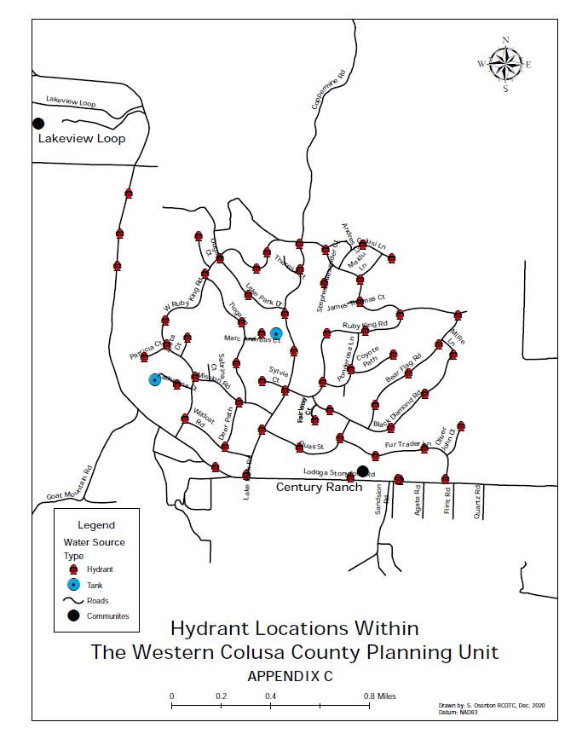
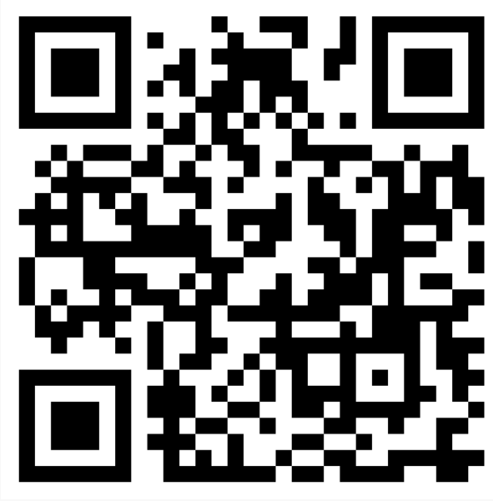
Water Delivery Systems
Improvements from our CWPP
Success Story: Tahoe Water for Fire Suppression Partnership

Slide 28
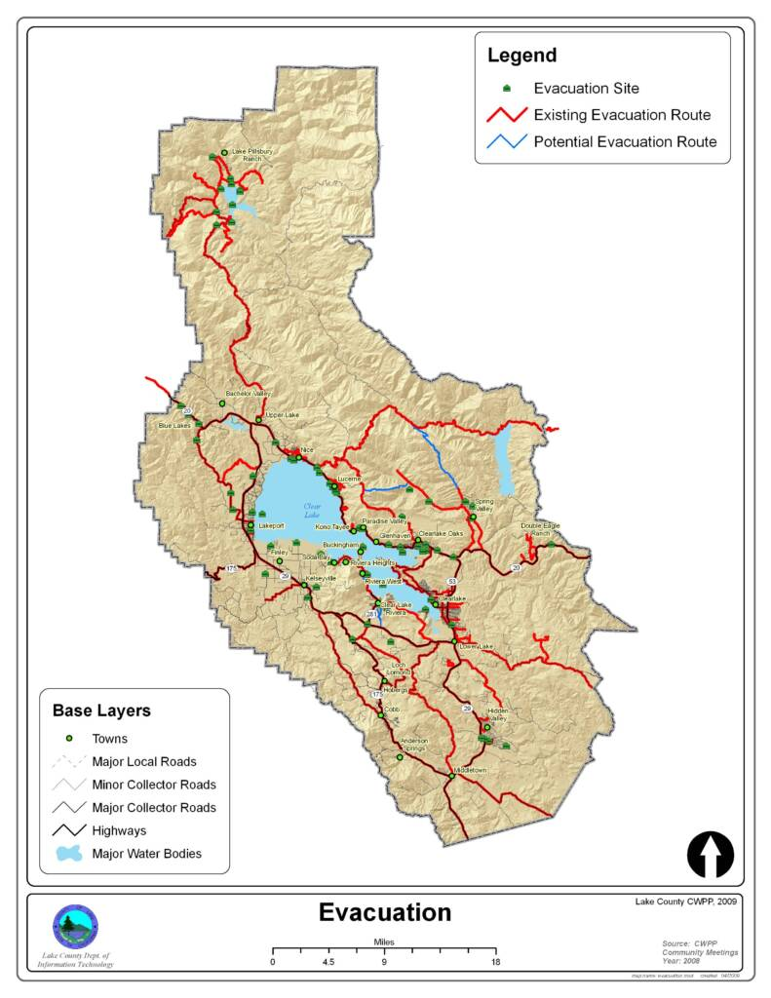
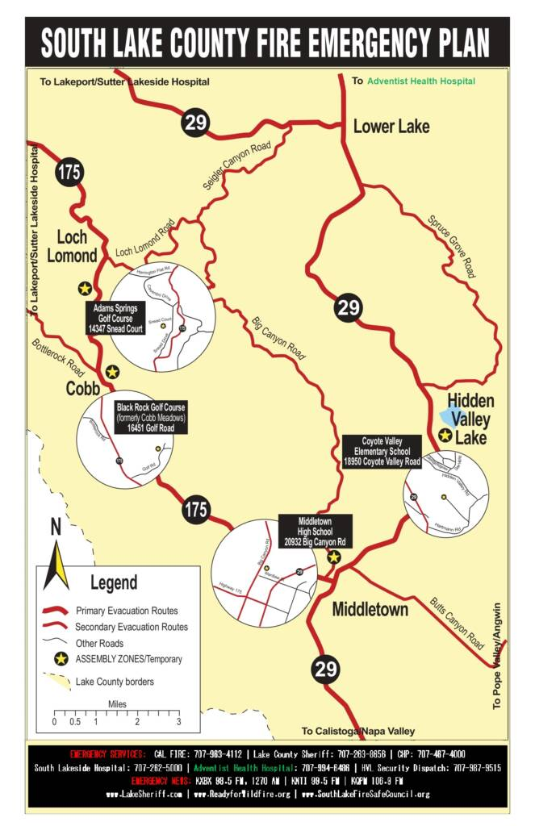
Emergency Planning
Rapid Notify System
Lake County Emergency Evacuation Routes and Zones

Slide 29
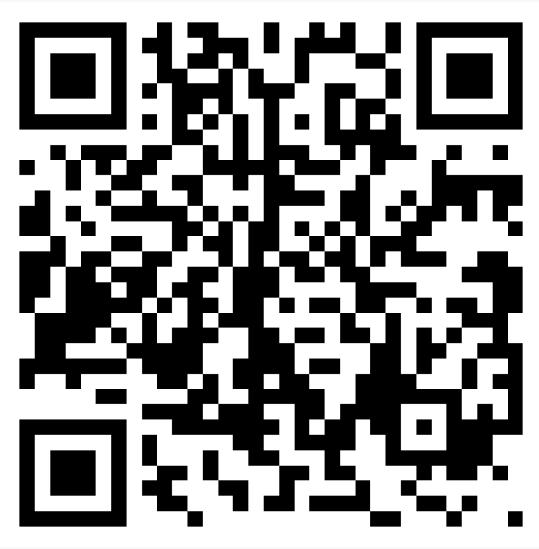
YOUR FEEDBACK IS NEEDED!
Eduardo@colusarcd.org
O: 530.458.5131 Ext. 117
W: 530.701.8443
100 Sunrise Blvd, Suite A-3, Colusa, CA 95932

